Slide 1

Trend Tracker
A term project by Aaron Taylor and Justin Gaskins

Slide 2
Agenda
The Idea
The Plan
Challenges
Current Features
Demo
Future Features
Questions

Slide 3

The Idea
Originally we wanted to analyze web traffic
Inspired by Google Trends and Social Blade
Collect and analyze trend data from different websites and networks
Notes:
Explain original Traffic Tracker idea
Originally planned to make a traffic tracker to track and analyze web traffic to different websites, using data from a traffic api
We ran into some challenges so we had to change course a bit
How the idea turned into Trend Tracker
Decided to use google trends instead of APIs
Inspired by trends and socialblade
Explain what socialblade and Google Trends are
Trends shows you how search queries have become more or less popular, but don’t give any insight into why
Sociablade is similar but measures user growth instead
We have feeds and articles to compliment the data
Basic use cases
Gauge public opinion
Stay in the know and never fall behind

Slide 4

The Plan
Focus Area 1: HTML, CSS, and graphics for page layout and design
Handled by Aaron
Design frontend with HTML and CSS
Add JavaScript interactivity
Focus Area 4: Pulling data from a real database
Handled by Justin
Design backend with JavaScript
Pull data from different sources (Google Trends, RSS, Twitter)

Slide 5
Trend Tracker
Enter a topic to start tracking!
RPI - Intro to ITWS Aaron Taylor, Justin Gaskins 2018

Slide 6
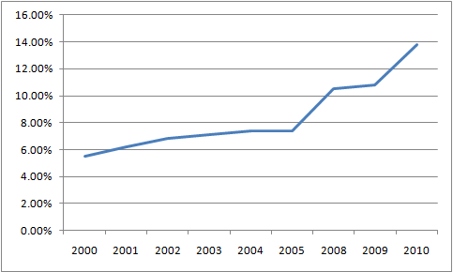
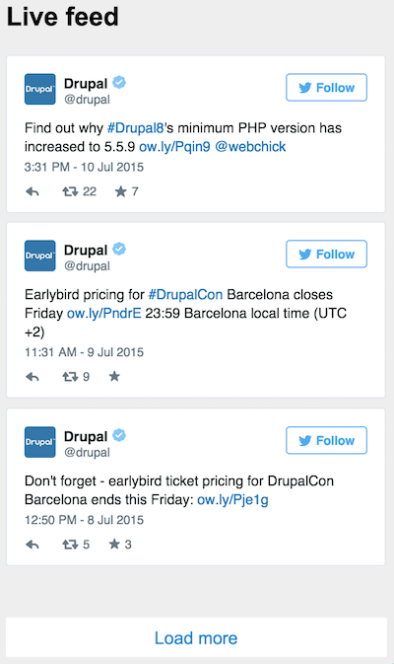
Trend Tracker
1. Enter a topic and. it’s history will be displayed on the graph
Help
2. View the changes in the topic’s popularity. You can adjust the date range with the dropdown menu.
3. You can view posts related to the site in the date range entered.
Enter a topic to start tracking!
30 days ⏷
RPI - Intro to ITWS Aaron Taylor, Justin Gaskins 2018

Slide 7
Trend Tracker
Help
Enter a topic to start tracking!
RPI - Intro to ITWS Aaron Taylor, Justin Gaskins 2018

Slide 8




Tools

Slide 9

Challenges
Direction change due to API limitation
Modifying embedded data
Notes:
Explain the Traffic Tracker problem with Similar Web and other apis
Had to make a huge direction change due to the speed at which API developers return contact, restricting access to the major tool we needed for the backend work
SimilarWeb wasn’t free and had to approve our project
Google Analytics also wasn’t free and basically only worked if you were the owner of the site you are tracking
Switched to using embedded data instead and using code to modify the embedded target fields

Slide 10
Current Features
Focus Area 1: HTML, CSS, and graphics for page layout and design
Functional splash page and dashboard
JavaScript interactivity (form validation, hovers, hide/show etc.)
Focus Area 4: Pulling data from a real database
Date range filter
Embedded feeds
Displays feeds and data from different websites and applications

Slide 11
Demo
Notes:
Explain the Traffic Tracker problem with Similar Web and other apis

Slide 12
Future Features
Integrate APIs instead of using embedded html
Add actual statistics for the trend
Add more sources for trend data
Notes:
Explain the Traffic Tracker problem with Similar Web and other apis

Slide 13
Questions?
Notes:
Explain the Traffic Tracker problem with Similar Web and other apis

